Slide 1
True health empowerment
A digital-first platform for change
Notes:
The biggest issues in health care seem bigger every day: rising costs, increasing needs, overall complexity.
At Anthem, we believe these issues are solvable. By creating a new kind of health care ecosystem that leverages digital technology and puts members first. By building a platform where health insurance can move toward health engagement and empowerment.

Slide 2
A new time and a new path to better health
With Sydney Health, we are reimagining health care by creating a new path to engagement that starts with each member — a platform connecting data, technology, and specific health needs in ways never thought possible. Until now.
Notes:
And we believe the time for transformation is now.
Long inspired by the responsibility we have for the health of our members, Anthem has used data, analytics, and digital technology to improve care and outcomes in ways that were never thought possible.
Today, we are uniquely positioned to rethink and rebuild health care so that it works better for members, for providers, for employers — for everyone.
In doing so, we are creating a new path to engagement, anchored by Sydney Health. Think of it as a front door to health care that starts with each member and orients around their specific needs.

Slide 3
Because people demand change
“Whenever, wherever, however” is the new normal
People increasingly prefer a digital environment and a consumer-centric experience.
AI and data intelligence have enabled better insights and more personalized health care recommendations.
Today
Projected in 2021
47% of employers offer apps and connected devices to reduce health risks
69%
44% of employers currently offer treatment decision support
65%
24th Annual Best Practices in Health Care Employer Survey, Willis Towers Watson, October 2019.
Notes:
Health care needs this kind of sweeping change — and members are more than ready for it. We all are.
Today’s consumers have high expectations for all transactions and interactions. Industries across the board have had to adapt quickly to this “right here, right now” demand for consumer-centric goods and services — even more so in a post-pandemic world.
For example, we know that:
Today, less than half of employers offer apps and connected devices to reduce health risks. In 2021, we expect that to jump to 69%.
While 44% of employers currently offer treatment decision support, a projected 65% of employers will be offering these by next year.
Bottom line: Employers are going all-in on helping employees make better health decisions. And Anthem has set the stage to deliver the trusted digital resources employers want.

Slide 4
Digital-first puts members first
Empire built a health care ecosystem that aligns resources, services, and care to specific member needs — seamlessly. One integrated solution gives employers the opportunity to streamline engagement, improve population health, and achieve long-term cost savings.
Leveraging vast sources of data to create more meaningful connections.
Using AI, machine learning, and predictive models that allow us to step in and help members take the right action at the right time.
Integrating this wealth of insights into every aspect of our business, changing how we operate and deliver value to employers.
Notes:
Anthem is committed to a digital-first approach and a member-focused health care ecosystem that aligns resources to specific needs.
That’s why, a few years ago, our leadership made the decision to adjust the company’s business model to focus on being a digital-first enterprise, leveraging technologies like artificial intelligence, machine learning, predictive analytics, and cloud technology to improve the process of care delivery.
Integrating this wealth of insights into every aspect of our business is changing how we operate and deliver value to customers.
These technologies and others are advancing so rapidly that what we know today is exponentially different than it was five years ago — and how it will be just a year from now. And, as I’ve mentioned, the pandemic has accelerated this trend even further.

Slide 5
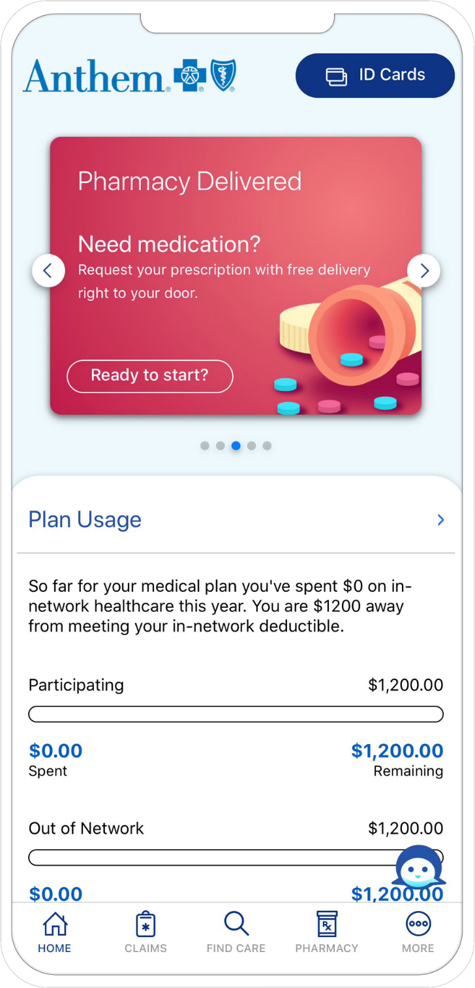
Sydney Health
One integrated home for better health
With Sydney Health, members have true single-point access to all their benefits, all tools and resources, under one roof.
Integrated benefit experience: Medical, Specialty, Pharmacy, Spending Accounts.
Quick tips and answers from AI-enabled chat to help navigate your benefits easily.
A complete, connected view of your health history via My Health Records.
Guidance on drug costs and options, plus easy Pharmacy refills with real-time order and shipping updates.
4.7
iOS App Store rating
(Ranked top ten in the Medical category)
Notes:
And at Anthem, our members are experiencing that digital-first future today with Sydney Health.
It provides true, single-point access to all benefits and health records, plus AI-enabled chat and powerful tools for understanding drug costs, giving members everything they need under one roof — finally.
With Sydney, members have access to all their benefits: Medical, Specialty, Pharmacy, Spending Accounts.
AI-enabled chat provides quick tips and answers to help members easily navigate their benefits.
My Health Records aggregates each member’s digital medical records for a complete, connected view of their health.
With Sydney, members also have tools to better understand their costs — and their options — when it comes to prescription drugs. Plus, they’ll get easy pharmacy refills with real-time order and shipping status so they’re always in the know on the medications they need.
These are just some of the reasons that members love the Sydney Health app — and rated it 4.7 stars on the iOS App Store.

Slide 6
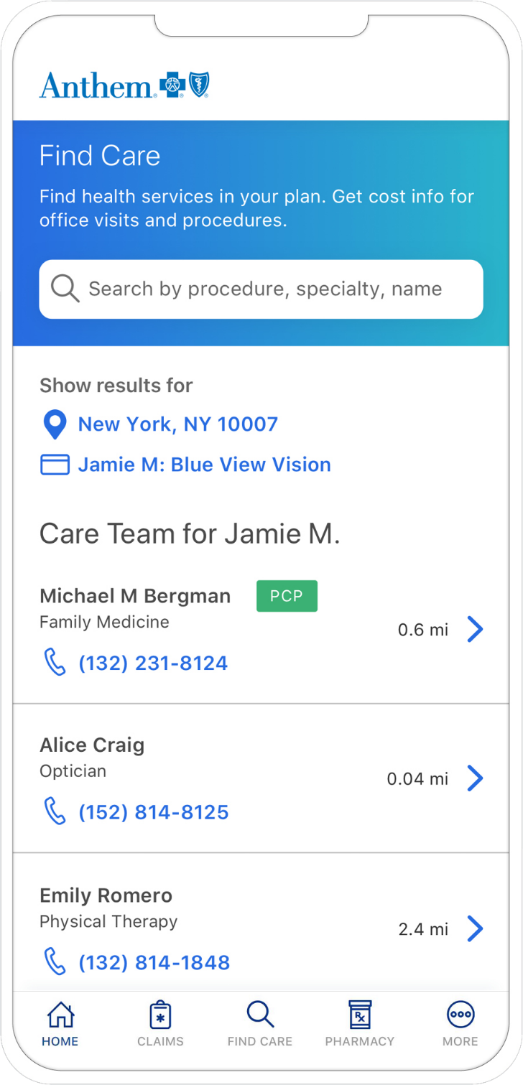
Sydney Health
Care guidance that is truly personal
Sydney Health provides members with insights based on their history and offers steps they can take for a healthier future.
Experience tailored to member claims, prescriptions, medical history, and hundreds of predictive models.
Personalized Match guides members to high-performing providers based on their plan and claims history, with additional layers to compare costs and specialists.
Reminders about wellness checks, essential clinical tests, prescription refills, and more.
Virtual care options help members check symptoms and then choose what’s best for them: text, video, or in-person care.
>40% of care searches completed through our mobile experience¹
¹September 2020
Notes:
Sydney Health offers a guided care experience that is personalized to each member, with insights based on history and recommended actions for a healthier future. This includes proactive tools, information and outreach to help improve health outcomes and financial performance.
Years of claims, prescription, and lab data fuel hundreds of predictive models that trigger an outreach when gaps in care are identified — for an experience that is tailored to each member.
Transparency tools use Personalized Match to guide members to high-quality, cost-effective providers based on their plan and claims history, with additional layers that help compare costs and specialty providers.
Reminders about wellness checks, essential clinical tests, prescription refills, and more — easily accessible from the Sydney Health dashboard.
Fully integrated Virtual Care options help members make decisions in real time. They get step-by-step, AI-driven guidance to assess symptoms and then choose the care that’s best for them: text chat, video visit, or in-person care.
Plus, more than 40% of care searches have been completed through our mobile experience— driving efficient ways to meet members where they are.

Slide 7
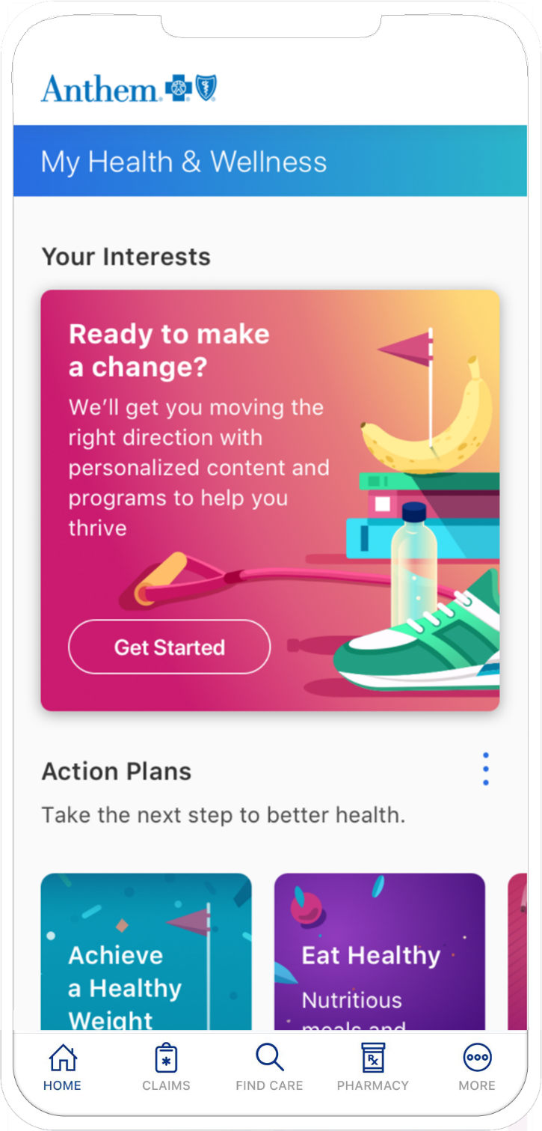
Sydney Health
Powerful tools designed to inspire real action
With Sydney Health, members receive more than reasons why to improve their well-being. They have actionable steps to take right now.
AI-powered communications encouraging members to be proactive and make smarter health choices.
Well-being approach that leverages13 risk models and 741K conditions to target members who are clinically or financially at-risk or diagnosed with a condition
Connectivity with fitness trackers, glucose monitors, and other devices to easily keep wellness data in sync.
My Health & Wellness Dashboard offering extra rewards and tools for personalized clinical action plans.
Real-time connection to wellness programs and medical professionals to resolve members’ health issues.
+131% utilization
of health and wellness tools¹
¹September 2020
Notes:
As the face of our digital platform, Sydney Health also makes sure members have not only reasons why they should improve their health, but easy ways they can act right now.
AI-powered messages encourage proactive — not reactive — health actions, helping members make smarter choices.
We leverage 14 risk models to better identify members who are clinically and/or financially at-risk. Members receive a risk score to help identify the likelihood of health events. Personalized care guidance for members is driven by clinical and financial risk conditions.
Easily syncs with fitness trackers, glucose monitors, and other devices, so members can connect with the all the ways they stay healthy, and you can easily create fitness challenges and incentives.
Through the My Health & Wellness Dashboard, we provide and personalized action plans to achieve the desired outcome. Members create personalized clinical action plans to help them reach health goals. Just some of the Clinical Action Plans available through Sydney Health include:
Achieve a healthy weight
Eat healthy
Get active
Increase energy
Reduce stress
Sleep better
Finally, Sydney Health features real-time connection to wellness programs, services and medical professional to resolve members’ health issues and close care gaps instantly.
Because of our focus on helping members be proactive and providing real steps they can take to improve their health, we’re seeing better adoption rates and driving more meaningful engagement — a 131% increase in app utilization of health and wellness tools.

Slide 8
A simple, unified experience, no matter how you connect
However members reach out, Empire connects them to better health in ways that fit their lives — all powered by Sydney.
Simplify your health care with intuitive digital tools.
Receive hands-free help from the Empire Skill with Alexa.
Nearly 60%
Talk to a real person by call, text, or interactive chat.
more digital interactions than phone calls as a result of the digital ecosystem
Notes:
Thanks to Sydney Health, it’s easier for members to connect digitally, on their own terms, in ways that fit best with how they live their lives. We’ve driven nearly 60% more digital interactions than phone calls, underscoring just how much digital has become members’ first choice for issue resolution.
It’s all part of creating a simple and unified member experience that empowers real choices, real change, and better health — no matter how you connect.
Simplify your health care with intuitive digital tools – Powerful self-service tools help members get things done easily — find care, compare costs, set personal preferences when searching for providers, and so much more.
By adding the Anthem Skill to their Alexa-connected devices, members can ask Alexa for quick answers to their benefits questions, request ID cards and other tasks.
Talk to a real person by call, text, or interactive chat – We know there’s no substitute for a real person who’s here to help. At Anthem, we make sure the human element is front and center for everyone, with Member Services teams you can reach through phone, text, or online. Find answers to basic health care questions or connect to other Anthem experts who can help you with health needs.
No matter how members connect, they are always connected to a powerful experience. One that’s personalized to them and anchored by Sydney.

Slide 9
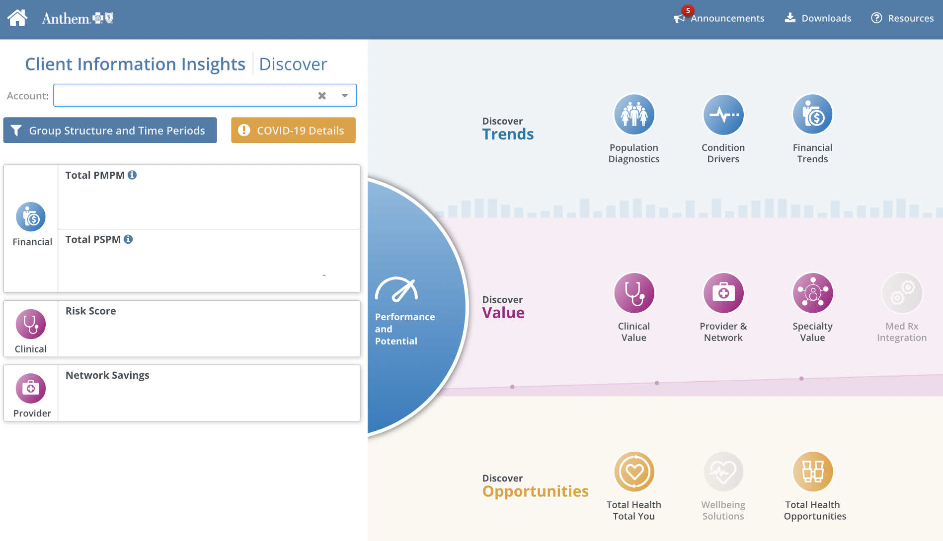
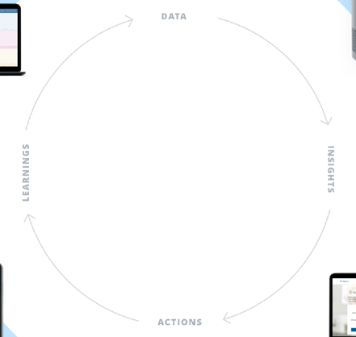
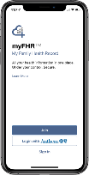
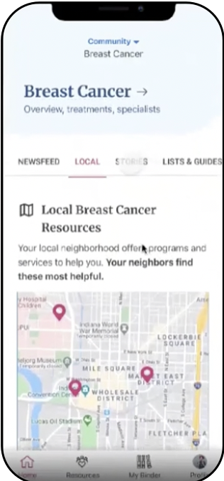
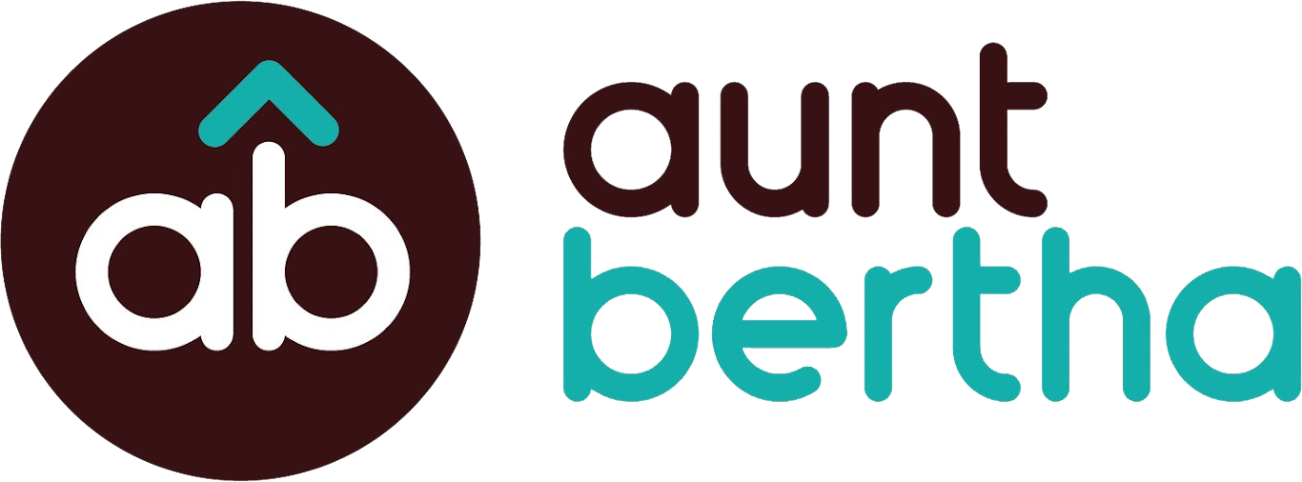
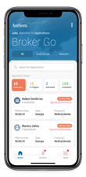
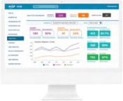
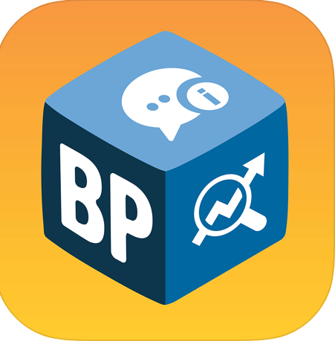
A cohesive, constantly
evolving platform
With our platform comes a fully integrated ecosystem that connects every point of interaction for every stakeholder —transforming the industry’s largest collection of health data into engagement-building insights and better outcomes.
As technology changes and grows, it is integrated into Anthem’s strategy and continues to meet the evolving needs of members.
Member
Provider
Sydney Health
Provider Care Management System (PCMS)
Member
Empire Skill (Alexa)
Employer
DATA
Client Information Insights (CII)
Member
Empireblue.com Member Portal
Empire
Digital Platform
Employer
Medicare
Employer Access
LEARNINGS
INSIGHTS
Shopper Portal
Health Consumer
Member & Non-Member
Community
Sydney Community
ACTIONS
Broker
Associate
Broker Plus
Operations Hub
Notes:
But it’s not just Sydney Health. It’s all part of Anthem’s cohesive, constantly evolving digital platform, the first of its kind in the industry — and that’s just the beginning.
Our platform fully integrates digital-first products and experiences into every point of interaction throughout the ecosystem. Together, we’re transforming the industry’s largest collection of health data into engagement-building insights and better outcomes.
Digital and data fuel every aspect of this platform — how members experience care through Sydney Health and Anthem.com; how providers share insights for better care delivery; how employers and brokers manage their plans and populations; and how the entire health care community works better together.
That’s how our single, digital-first platform connects the entire world of health.

Slide 10
Fast-tracking the future of digital care
Anchored by Sydney Health, our platform is enabling new possibilities that will transform what digital care can do.
Next-gen diabetes management
Real-time asthma intervention
Enhanced virtual care
Smart-synced glucose monitors and proactive, personalized recommendations for healthy eating.
Wearable sensors detect bio-indicators of upcoming asthma attacks, helping to lessen symptoms before they start.
In-home smart devices for sharing vitals and conducting routine exams via video with a clinician, such as heart, lungs, ears, etc.
Notes:
As a platform, Sydney Health can quickly integrate any future innovation and connect people to new possibilities in digital care.
Imagine a world where we can predict asthma attacks before they start. Or your doctor being able to listen to your heart remotely, just as they would during a physical exam. It’s a future that makes it easier than ever for people to manage conditions from home — from everyday health needs to chronic conditions like diabetes.
A future that’s only possible with a digital-first platform powered by Sydney Health.
=============
[optional in-depth detail]
Currently, we are seeing a major transformation in diabetes care. By syncing glucose monitors with Sydney Health, we can deliver enhanced insights that help members better understand and manage their diabetes. Plus, members can receive tailored health news and content, as well as proactive action plans for what to eat and even what to look for at the grocery store.
For those with asthma, we can truly change lives by detecting bio-indicators of upcoming asthma attacks. The asthma digital intervention uses sensors to understand baseline symptoms, then educate and provide delivery of medication to the patient. Integrated with Sydney Health, this new remote monitoring experience will help members control their asthma and avoid increases in symptoms that can lead to costly ER visits and admissions.
Our digital platform is also revolutionizing telemedicine and virtual care. Using advanced new technology, members can actually take routine exams from home. Not only sharing vitals, but also everyday screenings of their heart, lungs, ears, throat, skin and more — all guided live on video chat with a clinician. And again, it’s all channeled through Sydney for a cohesive checkup experience from the comfort of your own home.

Slide 11
The right platform. The right moment. The right partner.
People deserve a world where managing health is seamless. Where a healthy life is accessible to everyone.
At Empire, we’ve created that world for you and your employees — and we’re just getting started.
Notes:
People deserve a world where managing health is seamless. Where a healthy life is accessible to everyone.
At Anthem, we’ve created that world for you and your employees. And we’re just getting started.

Slide 12
Appendix

Slide 13
A deeper level of simplicity, personalization, and engagement for the entire employee population—not just Empire members
Sydney Preferred
Benefit and claims hub
Third-party integration
Non-member support
Incentives
Transparency
Wellbeing and engagement challenges
Onboarding/campaigns
Custom messaging
Co-branding
Reporting
Notes:
Sydney Preferred is a premium, buy-up solution that delivers what employers truly need: one, fully integrated hub that unites all employees and benefits, helps build a culture of wellbeing, and delivers a personalized experience designed to lower costs and improve health for everyone.
Using Sydney Health as the foundation, Sydney Preferred adds third-party integrations and enhanced engagement features allowing us to personalize the experience to the needs of each employee—whether or not they are an Anthem member.
Now let’s take a closer a look at Sydney Preferred in action.

Slide 14
Sydney Preferred
One digital experience for all your benefits and all employees
Sydney Preferred unites everything into a single, fully integrated benefit hub.
Focus on health with everything employees need in one place.
Simplify access to all benefits, providers, and programs.
Seamlessly connect ancillary partners, right in the Sydney Health app.
Bring all employees on board, even those who do not have Empire coverage.
Notes:
With Sydney Preferred, you finally have one digital experience for all your benefits, all employees, all under one roof.
No more using different apps for different tasks. Sydney Preferred offers a single, trusted digital experience that helps all employees focus on their health more easily, because everything they need is in one place.
Sydney Preferred connects access to everything: medical, pharmacy, specialty, spending accounts and all other providers, along with wellbeing programs and health care services.
You can also add ancillary benefit partners right here in Sydney Preferred, using direct link, Single Sign-On (SSO), or API, for a more cohesive experience—on the front end and the back end.
Most of all, you have a place to bring all employees are on board—even those who do not have coverage through Anthem. You’ll find all benefits from other carriers, right on the Sydney Health app. Finally: something for everyone.

Slide 15
Sydney Preferred
A member-first approach to better health
Powerful personalization draws employees in and drives engagement.
Next-level personalization engine delivers a relevant, engaging health care experience.
Engagement programs empower members to set health goals and make smarter choices.
Wellness content and challenges keep employees active and motivated.
Onboarding and engagement campaigns give members a reason to keep using Sydney.
Notes:
We all understand the power of personalization, especially when it comes to health care. And so does Sydney Preferred—using data to drive a more personalized, relevant and engaging experience that helps guide members to better health.
Next-level personalization engine delivers content relevant to each employee to truly make a member’s health care experience simple, personal and engaging.
Engagement programs are designed to empower employees to set health goals and make smarter lifestyle choices.
Wellness content, fitness challenges, milestone rewards, and nudges of encouragement keep employees engaged with personal health goals.
Onboarding and engagement campaigns encourage employees to download and use Sydney Health to stay involved and take an active role in their health.

Slide 16
Sydney Preferred
Health and wellness that feels like an extension of your culture
Now you can more easily integrate wellbeing into your everyday work experience.
Co-brand the experience to show employees how you are investing in better health.
Customize challenges to build camaraderie and teamwork throughout your company.
Create custom messaging that aligns with your culture and business goals.
Notes:
Sydney Preferred makes it easy to make health and wellness feel like an extension of your culture—not just another add-on.
Employers can co-brand and customize the experience, so employees feel comfortable and see Anthem and their employer are investing in better health.
Customize challenges to build camaraderie and teamwork based on a broad range of criteria, such as type of job, department, location, and more.
Custom messaging aligns to your culture and business goals, delivered by in-app messaging, push-notifications, and secure mailbox.

Slide 17
Services provided by Empire HealthChoice HMO, Inc. and/or Empire HealthChoice Assurance, Inc., dba Empire BlueCross and BlueShield. Independent licensees of the Blue Cross and Blue Shield Association, an association of independent Blue Cross and Blue Shield plans.

